Slide 1
D
S
C
5
1
0
3
Statistics
Term Project
Predicting tree type based on surrounding characteristics
Prepared for: Prof Wang Tong
Prepared by: Lyu Peijin, Man Kah Ho Sherman, Wang Yi, Yau Chung Yin Jack

Slide 2
Agenda
Introduction
-Sherman
Models
- Jack
Results
- Wang Yi
Conclusion
-Peijin
Project Overview
Data origins
Sample Preparation
Logistic Regression KNN, Regularization, Tree-based methods
Evaluation of Results
Further application of techniques

Slide 3
1
Introduction
Overview, Sample Preparation, Strategy

Slide 4
1
Topic to do with Nature / Environment
Available Data Sets
Application of acquired statistical techniques
Project Motivation
Dataset: Tree types found in Roosevelt National Forest in Colorado
Topic: Predicting tree types based on surrounding area characteristics

Slide 5


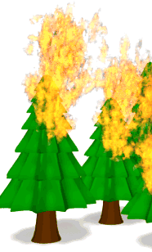

1
Data Set
Y: Cover_Type
Integer 1 to 7
Spruce/Fir
Lodgepole Pine
Ponderosa Pine
Cottonwood/Willow
Aspen
Douglas-fir
Krummholz
Wilderness Area
Hillshade Index
4 different wilderness areas within Roosevelt National Forest
4 binary columns
Hillshade index at 3 different times of day
Soil Type
40 binary columns
Distance To Roadways
Distance To Fire Points
Horizontal Distance to nearest Roadway.
Horizontal Distance to nearest wildfire ignition points
Elevation, Aspect, Slope
Elevation in meters, Aspect in degrees azimuth, Slope in degrees

Slide 6
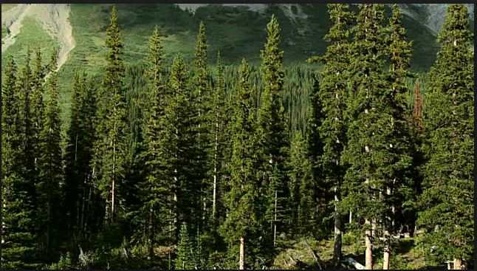
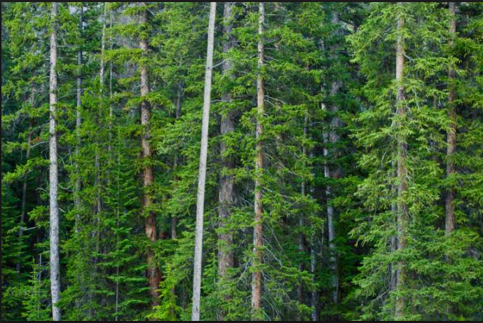
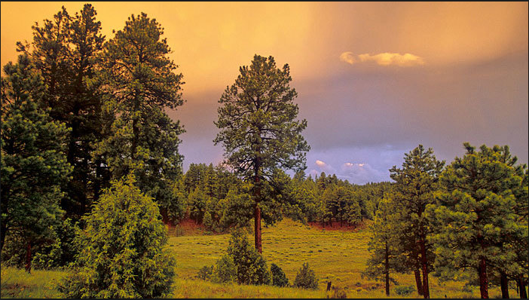
1. Spruce/Fir
Cover
Types
2. Lodgepole Pine | 3. Ponderosa Pine

Slide 7
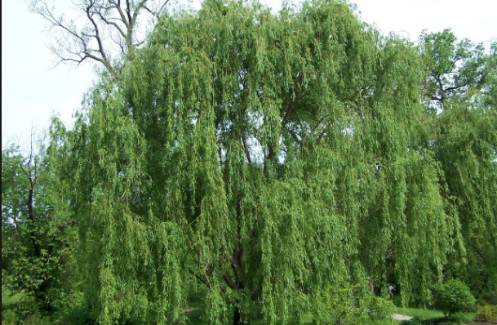
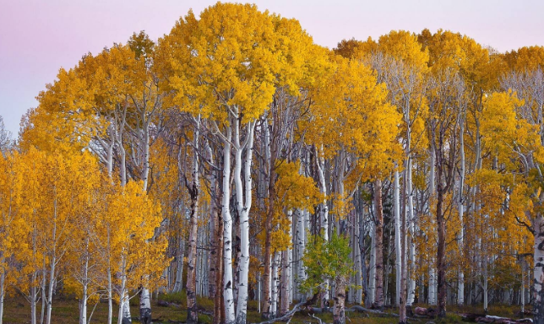
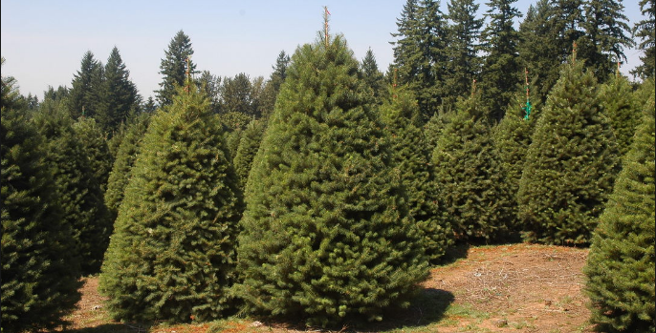
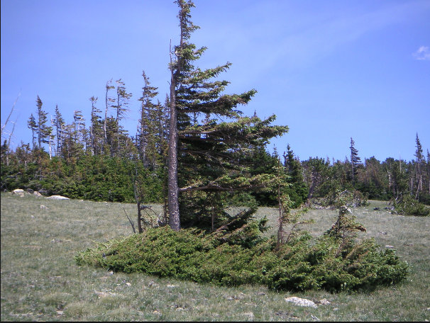
4. Cottonwood/Willow | 5. Aspen
6. Douglas-fir | 7. Krummholz

Slide 8
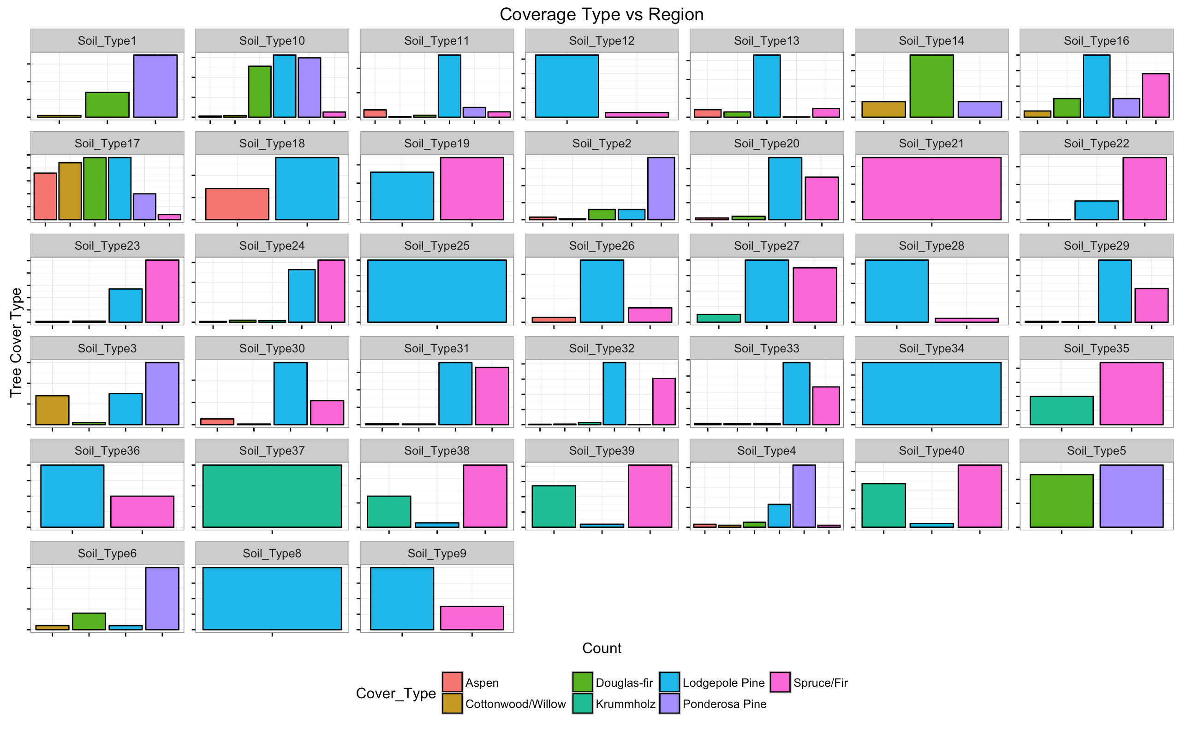
Tree cover found in each Soil Type

Slide 9
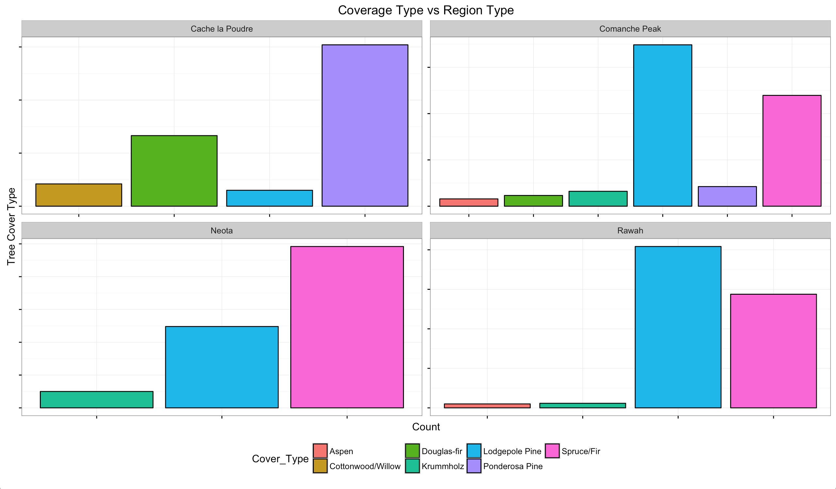

Slide 10
2
Models

Slide 11
1
Data preparation
Original Data Set
The original data set from kaggle contained 580,182 observations.
580,182
Trial Run
Sampled ~10%/50,000 rows with 40,000 training data and 10,000 test data observations
Resulted in severely long run times for Regularization CVs and Tree-based method tunings
Actual Run
Sampled 10,000 rows

Slide 12
Data preparation
20%
80%
10,000
observations
2,000
Test Data
8,000
Training Data

Slide 13
1
Multinomial Classification problem
Dependent variable forest tree cover type is categorical, taking integer values 1 to 7
Suitable Techniques
Consider the different methods we learn in class and decide which are suitable
Apply the necessary arguments such as family="multinomial"
Evaluation of Methods
Compare the misclassification error of the various methods

Slide 14
Tuning
Models
CV
PART 1
PART 4
KNN Algorithm, Logistic Regression
EM & comparison of result
PART 2
PART 3
Regularization Methods
Tree-based Methods

Slide 15
3
Results

Slide 16
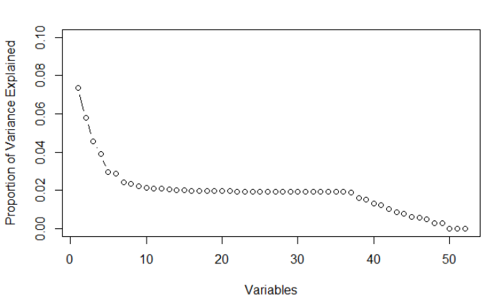
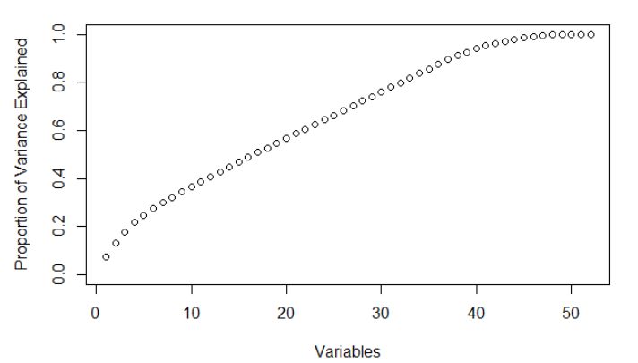
PCA
Proportion of Variance
Aggregate Proportion of Variance
Notes:
This is the result from PCA, and we can see actually for our dataset, every conp influence the type result more or less, so here we keep all the data for the following steps.

Slide 17
Model | Accuracy | AUC
Bagging | 0.801 | 0.755
Random Forest | 0.776 | 0.749
KNN | 0.753 | 0.721
GBM | 0.737 | 0.673
Logistic Regression | 0.732 | 0.682
Lasso | 0.729 | 0.679
Elastic Net | 0.724 | 0.674
Ridge | 0.714 | 0.655
Tree | 0.67 | 0.614
Ensemble (0.7*Bagging + 0.3*RF) | 0.8035 | 0.8474
Much better than pure guess !!! (1 / 7 = 0.144)
Notes:
We used different models to predict the type, and the accuracies are between 67.0% - 80.4%, which are much better than pure guess (one of seven, pred.ens)
* the gbm we use
Ensemble model is the best, as evaluated by accuracy rate / AUC / ROC

Slide 18
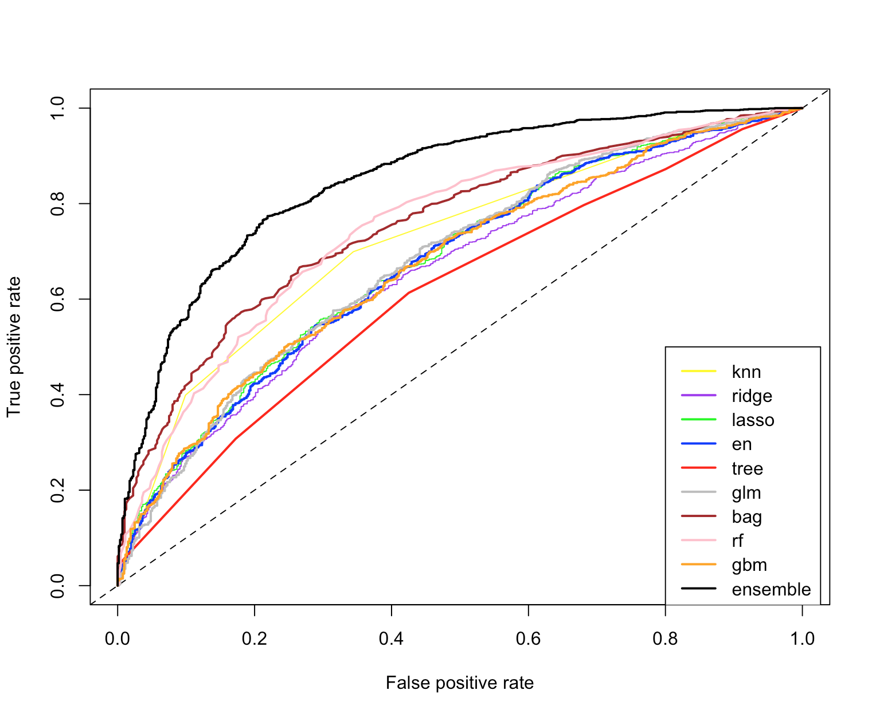
ROC Plot

Slide 19
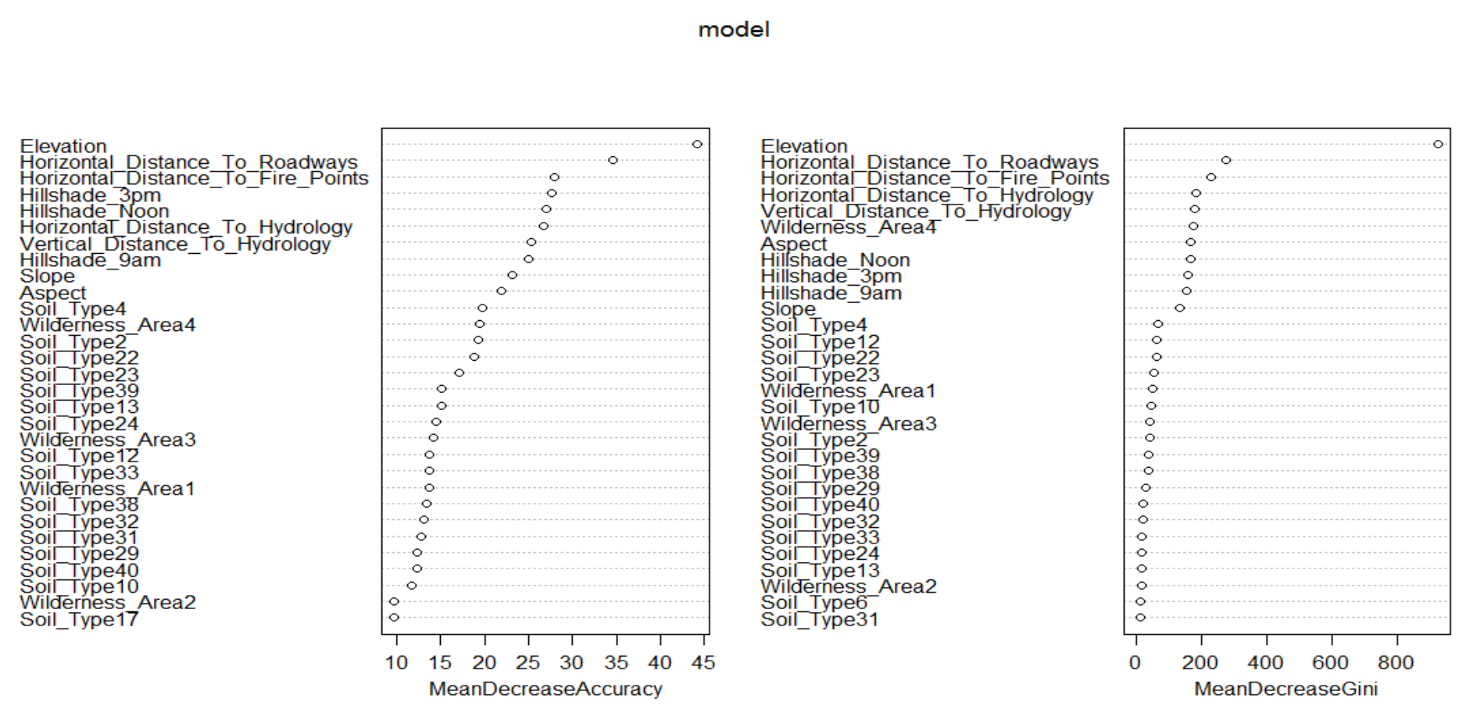
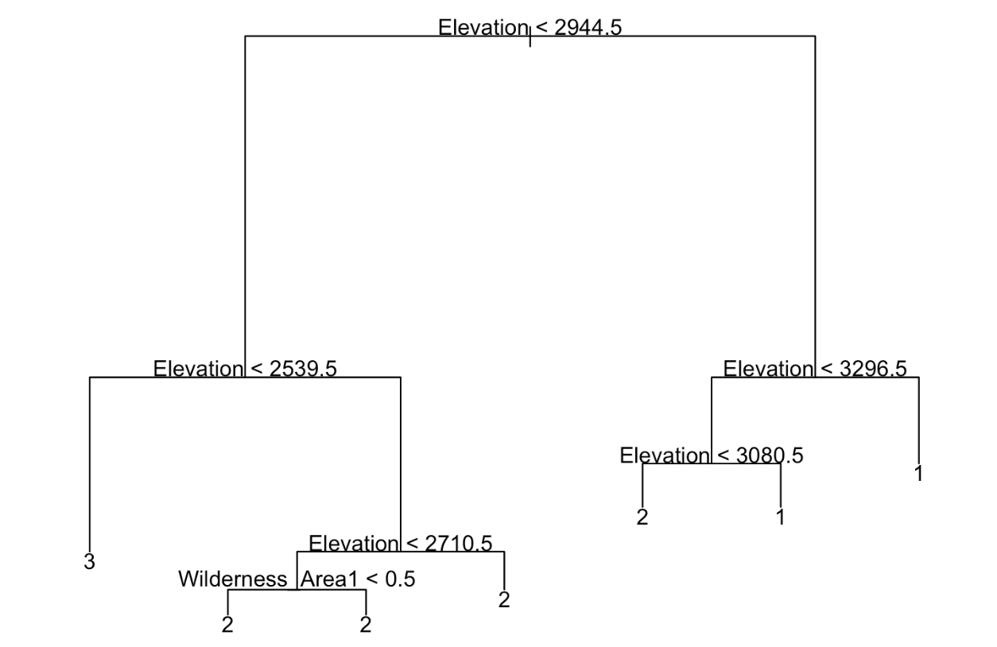
Elevation is the most important variables – Tree / RF / GBM
Random Forest
Tree
Notes:
We used different models to predict the type, and the accuracies are between 67.0% - 80.4%, which are much better than pure guess (one of seven, pred.ens)
* the gbm we use
Ensemble model is the best, as evaluated by accuracy rate / AUC / ROC

Slide 20
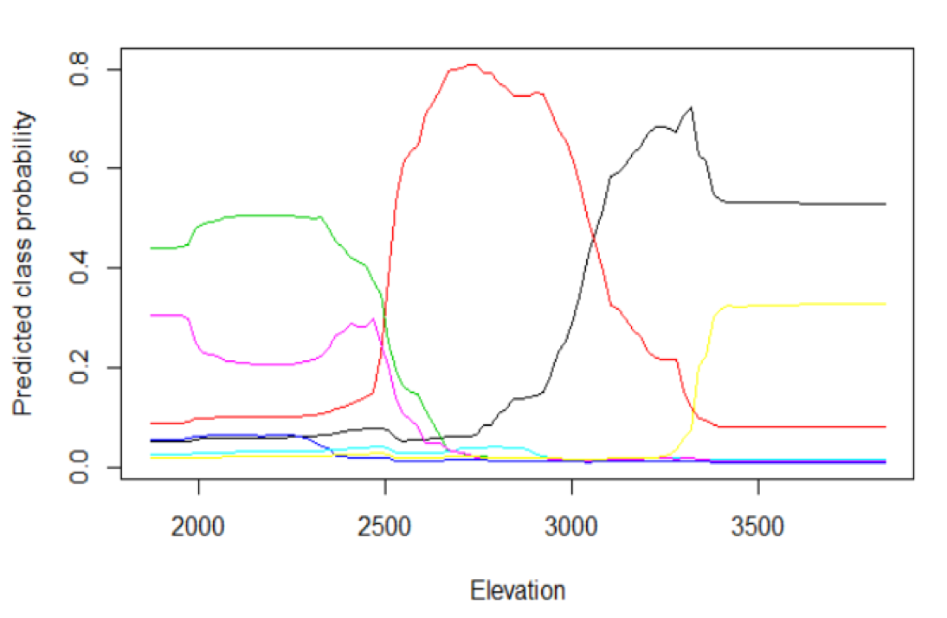
GBM - Partial Dependence
1 - black
2 - red
3 - green
4 - blue
5 - light blue
6 - pink
7 - yellow

Slide 21
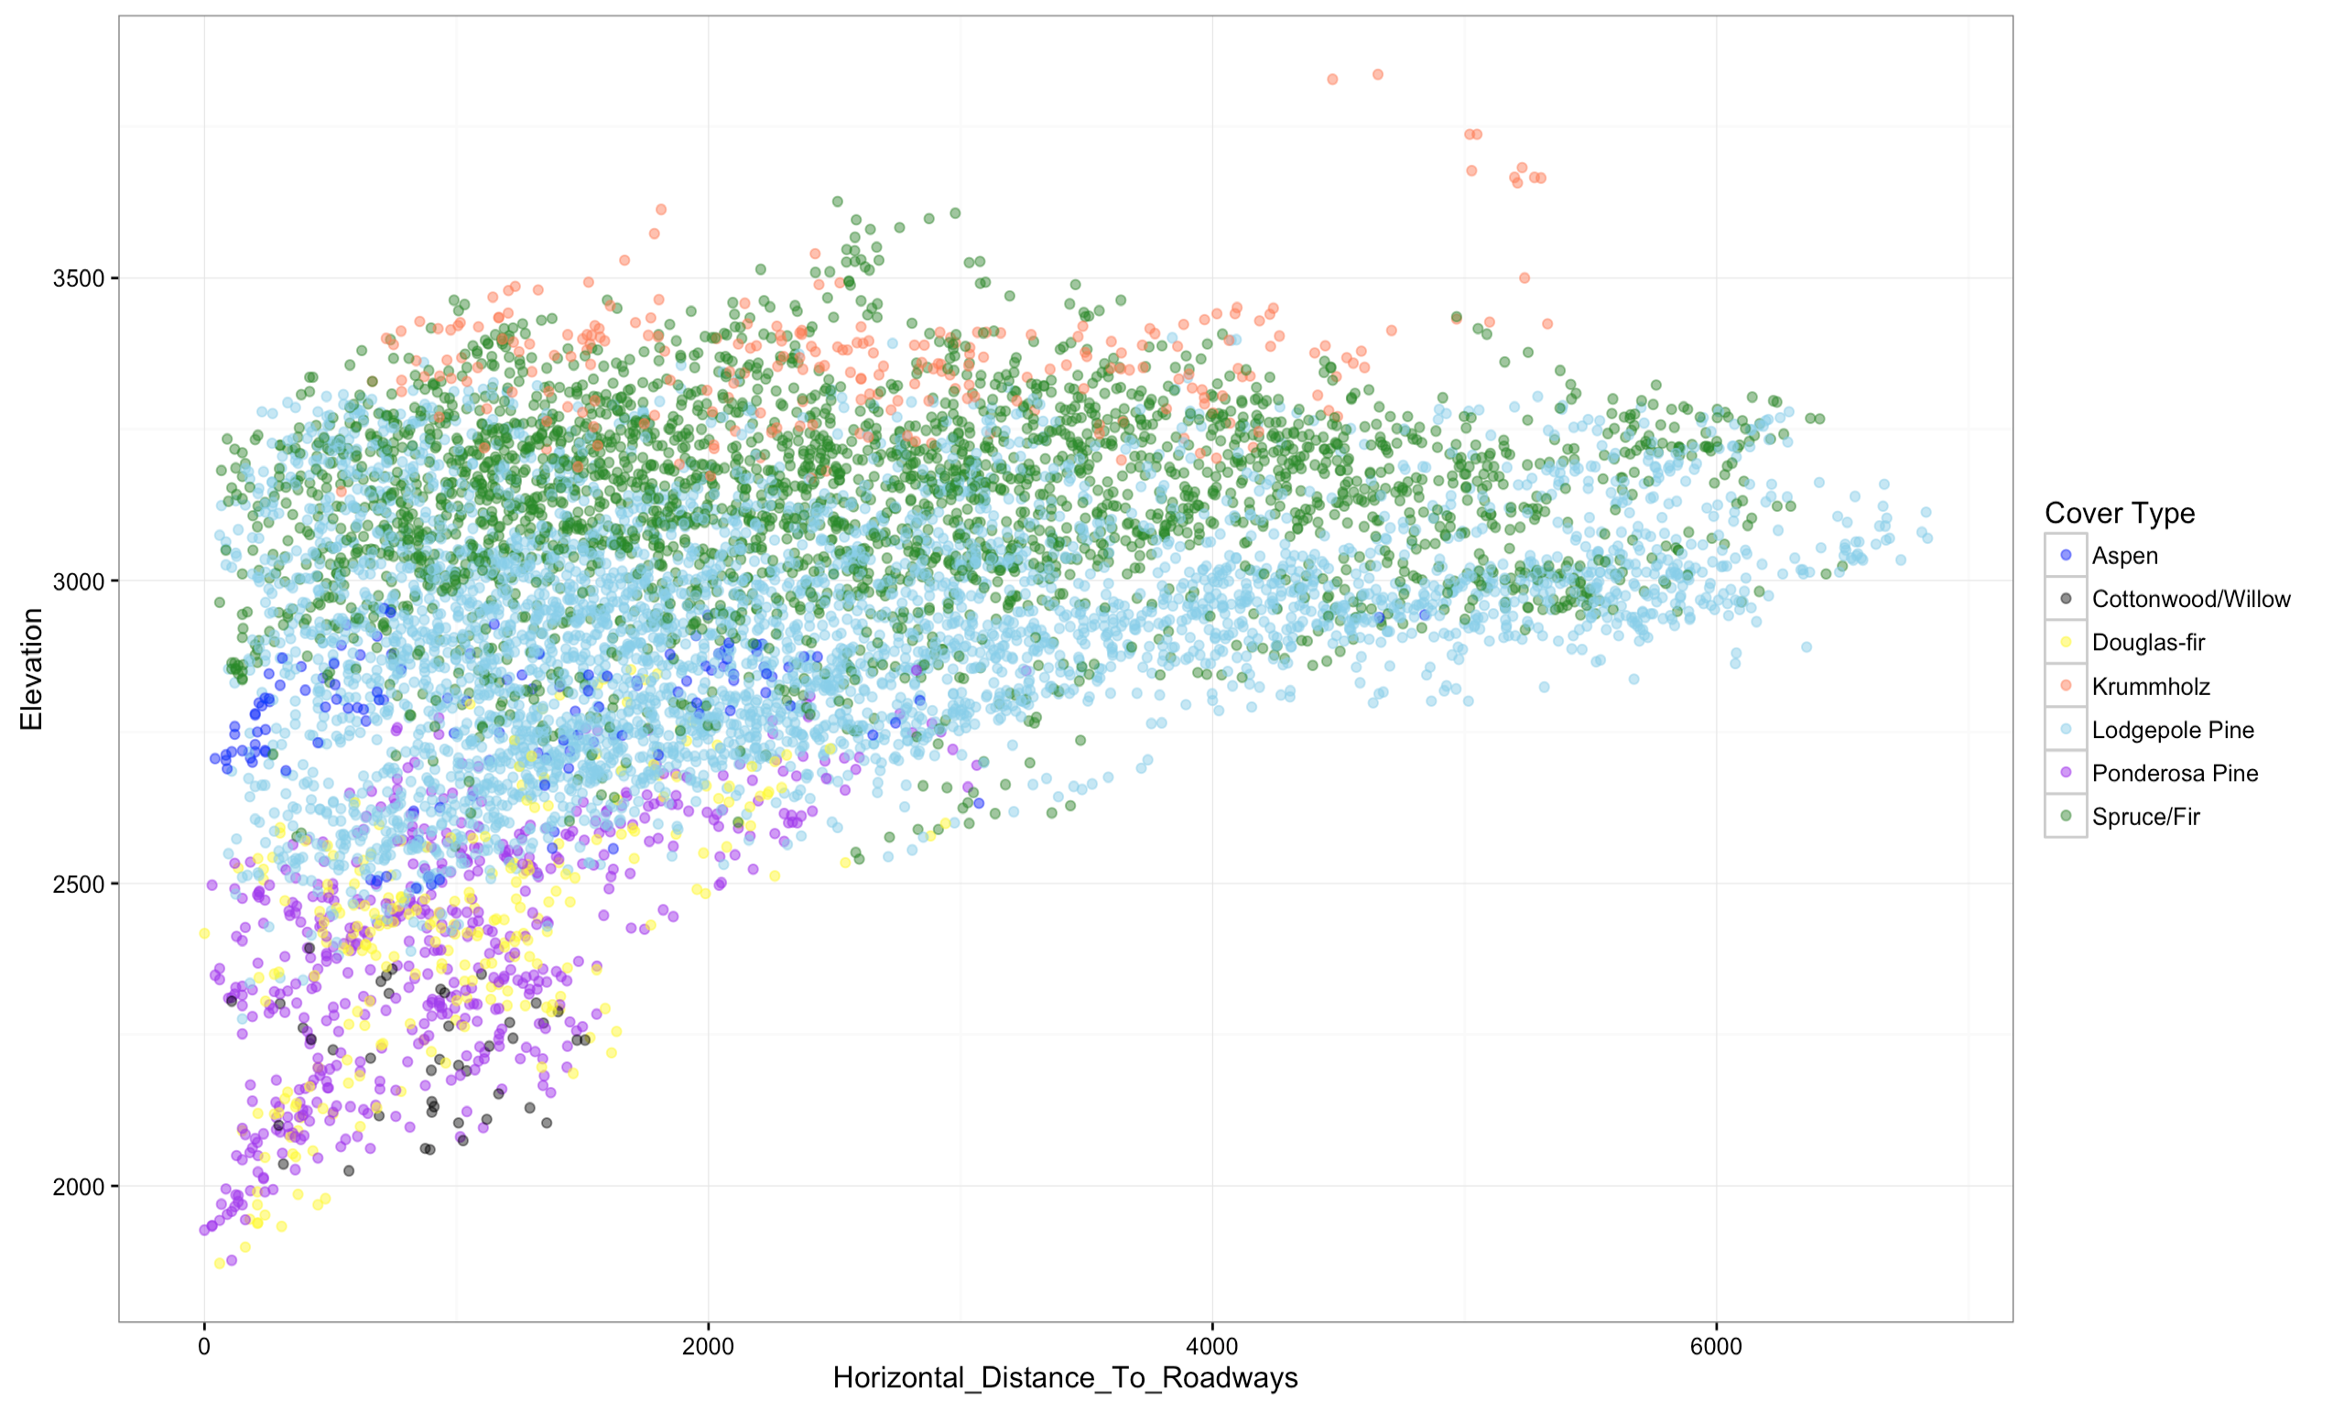
5
4
6
7
2
3
1

Slide 22
4
Conclusion

Slide 23
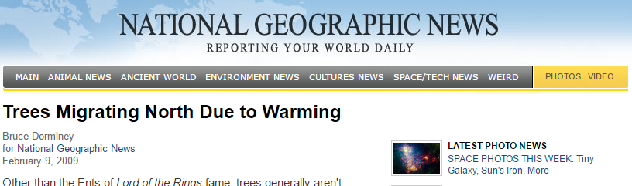
Result Application
Environmental Conversation
Protection Policy planning to conserve specific species of trees
Establishment of new parks
Species of trees to import and the environment necessary to grow them (e.g. Gardens by the Bay)
Optimize planting location of different tree species
Analyze forest migration patterns
Studies have shown that tree seedlings are
growing at higher altitude relative to their adults
Scientist attribute this to climate change issues causing tree species to grow at higher elevation to stay within ideal temperature zones

Slide 24
Possible Improvements
Inclusion of more variables:
Climate / Weather data: Rainfall, temperature
Wildlife species
Improvement of Model
GBM tuning
Redefining the problem in various ways
E.g. binomial to predict tree type family

Slide 25
T
H
A
N
K
S

